Slide 1

Visualisation with R
Andrew McLean
andrew.mclean@ed.ac.uk

Slide 2
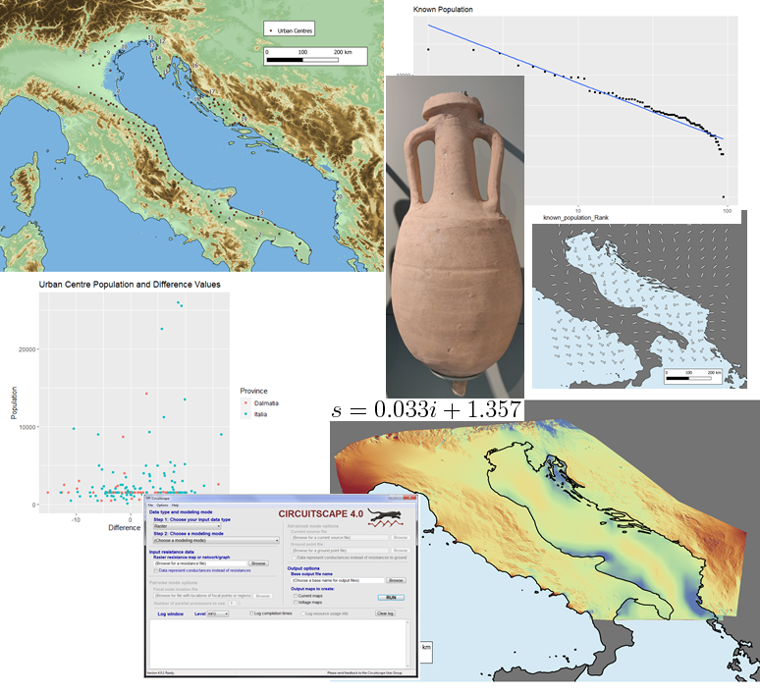

Before Starting…
PhD candidate in Classics/Archaeology at the University of Edinburgh
Training Fellow with DCS

Slide 3
Before Starting…
The Workshop
Format: Work through code together on R Studio – discuss questions as we go
Learning outcomes: Develop a basic understanding of data visualization, analysis and plots in R
Two parts
26 Oct 2021, 12:00 – 14:00
Basic plots, ggplot syntax and types of plots
2 Nov 2021, 12:00 – 14:00
Good and bad data visualisation, more advanced possibilities and more practical problem solving with example data

Slide 4
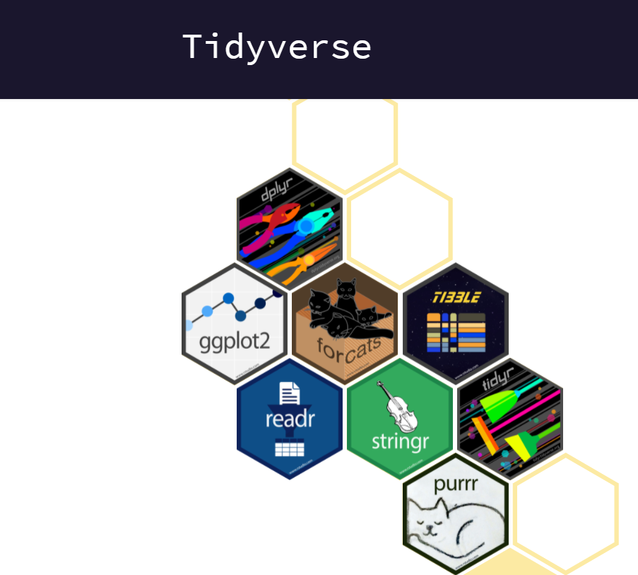
What is R and RStudio? Packages
As open-source software, there are a huge number of packeages available through R
A very commonly used package is ‘tidyverse’
This combines a number of important packages, and is the main package we will use during the classes
> install.packages(‘tidyverse)
https://support.rstudio.com/hc/en-us/articles/201057987-Quick-list-of-useful-R-packages
https://www.tidyverse.org/

Slide 5
Projects and Working Directories Good practice
Have a separate project for each data analysis
Keep your data, scripts and associated files somewhere in the working directory
Save outputs to a separate folder in the working directory
> getwd()
[1] "C:/Users/amclea/OneDrive - University of Edinburgh"
> setwd(“..")
https://r4ds.had.co.nz/workflow-projects.html
https://www.rstudio.com/wp-content/uploads/2015/02/data-wrangling-cheatsheet.pdf

